Slide 1
Automatic Brain Tumor Detection

Slide 2

Group Members
Md. Abdullah
ID: 16301136 (sec01)
Sadia Alam
ID:14301108 (sec01)
Adiba Shuhin
ID:14301080 (sec03)
2

Slide 3
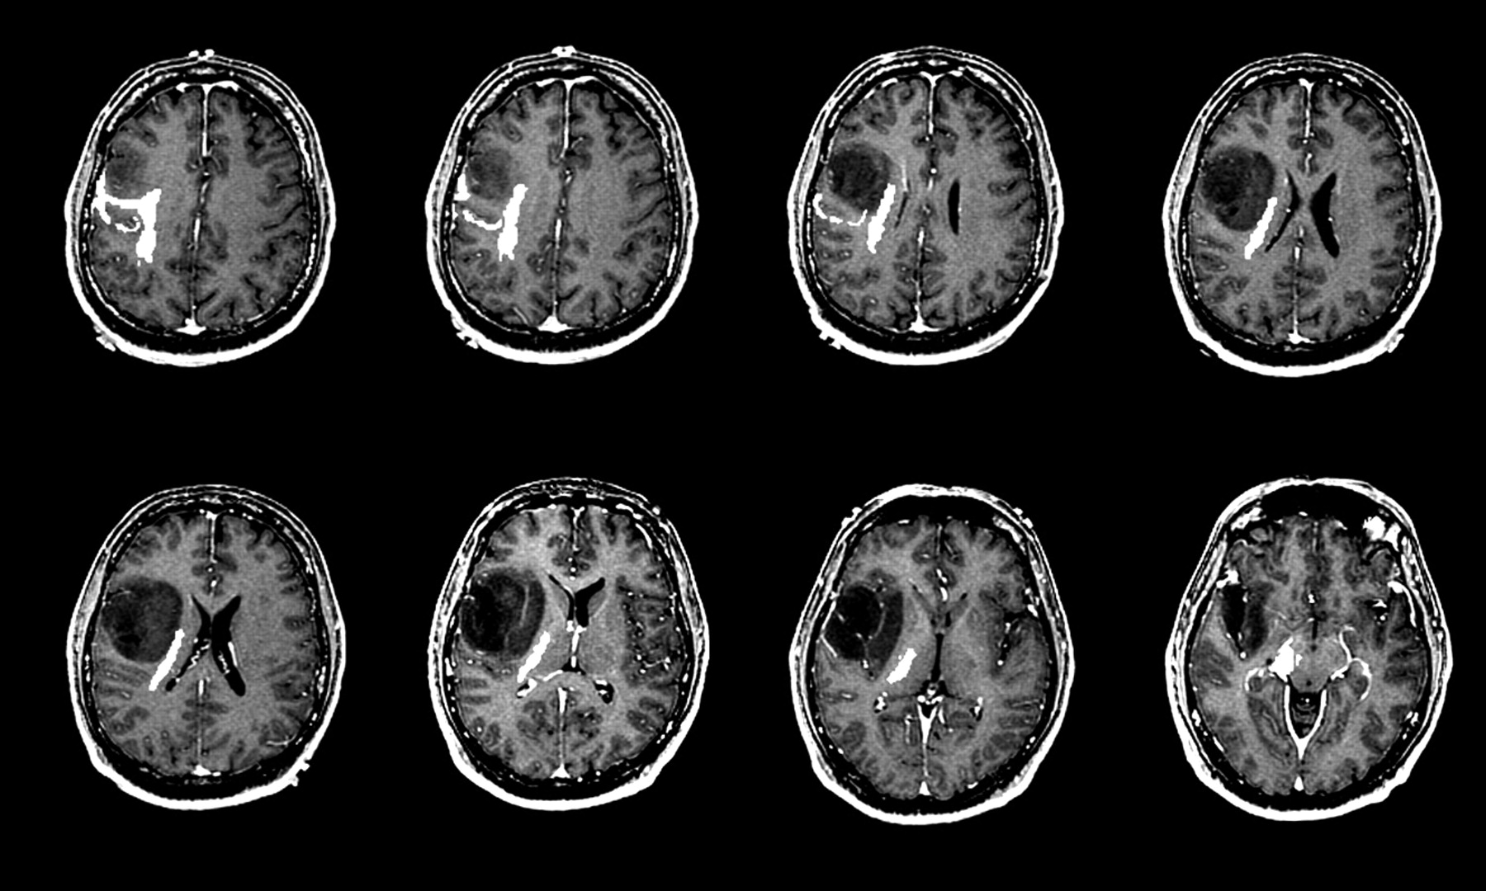
Brain Tumor Imaging, MRI image
Figure 1: MRI dataset images
3

Slide 4
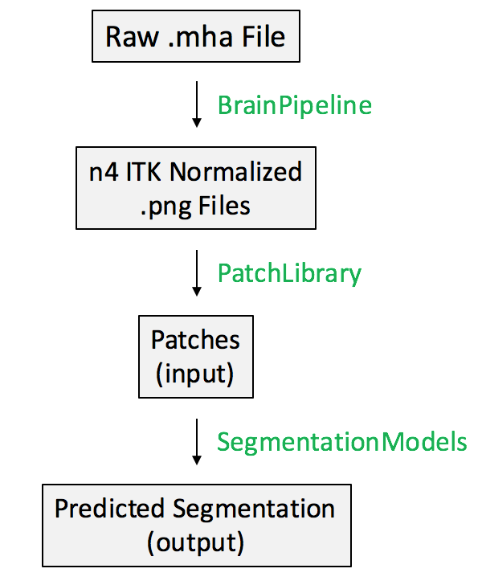
Working Plan
Input From DATASET
Normalization
Patches
Prediction of Segmentation.
4
Figure 2: Work process of our model

Slide 5
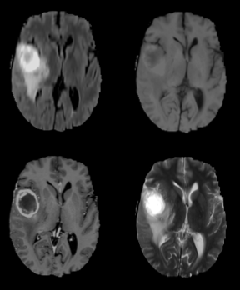
Details about the Dataset
Contains four different MRI pulse sequences
Comprised of 155 brain slices
Total of 620 images per patient
Source: 2015 MICCAI BraTS Challenge
Figure 3: MRI pre-processing
5

Slide 6
Explanation about the Algorithm
MRI pre-processing:
higher intensity of the image
Pulse sequences:
used to illuminate different types of tissue
Figure 4: The processing and segmentation of MRI image
6

Slide 7
Explanation about the Algorithm (cont.)
Segmentation:
600 images need to be analyzed per brain
has the potential to decrease lag time
(between diagnostic test & treatment)
7

Slide 8
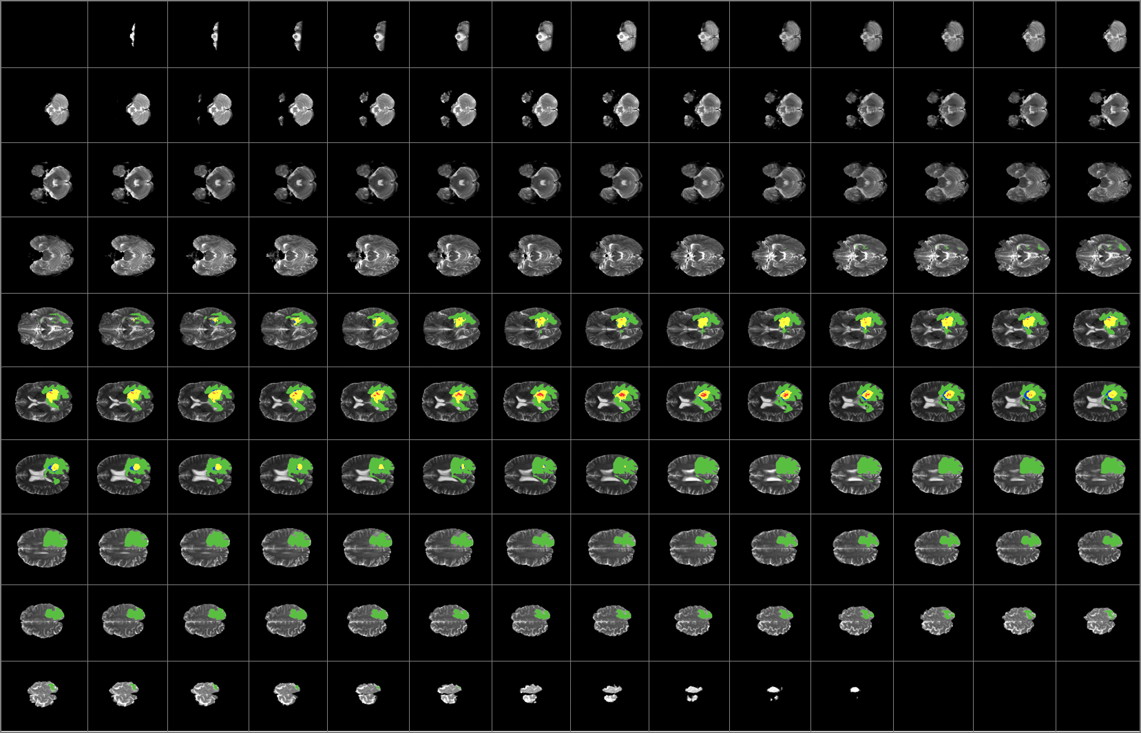
Explanation about the Algorithm (cont.)
Figure 5: Segmentation
8

Slide 9
Explanation about the code/library
Used Library: (in our program)
numPy
patch_library
matplotlib
keras
skimage
sklearn
9

Slide 10
Explanation about our Program
We have collected the following code from github
Automatic Brain Tumor Segmentation
Retrieved From: https://github.com/naldeborgh7575/brain_segmentation
10

Slide 11
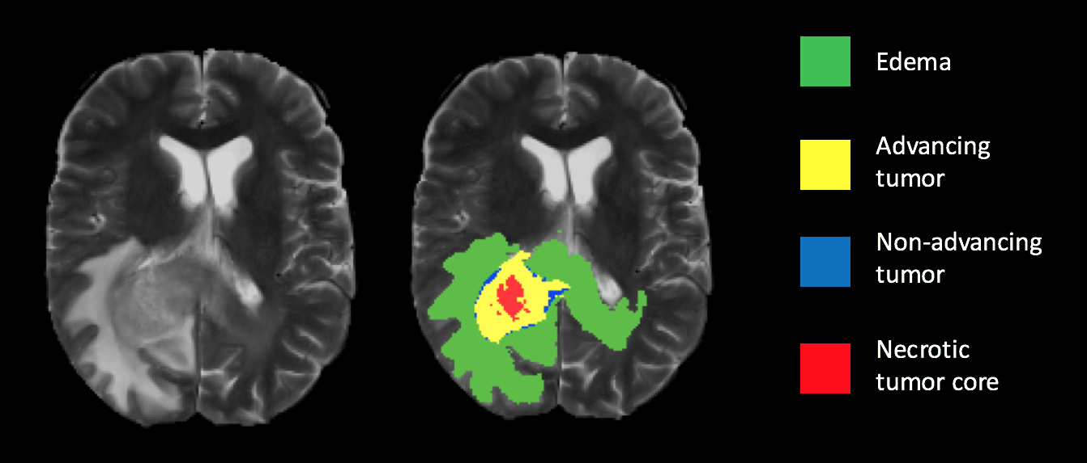
Result
Below is the diagram of how the model is predicting
Figure 6: Result of our proposed model
11

Slide 12
Conclusion
Hoping to publish our paper
Have great expectations from this project
Will be a great help to detect diseases without errors
Faster process than now and will save a lot of lives
Will maintain proper accuracy and efficiency
12

Slide 13
References
N.Aldeborgh,”Automatic Brain Tumor Segmentation”,2017
S. Mallick, “Image Recognition and Object Detection”, 2016
Retrieved from: https://www.learnopencv.com/image-recognition-and-object-detection-part1/
Dataset
Retrieved from:
https://public.cancerimagingarchive.net/ncia/searchMain.jsf
http://www.insight-journal.org/rire/download_data.php
Sample Images
Retrieved from: http://vision.cse.psu.edu/people/chenpingY/tumor_main.html
13

Slide 14
THANKS!
ANY QUESTIONS?

